Slide 1
Analítica de datos en segundos con Amazon Athena
Arturo Bayo
Consultant, Big Data, Amazon Web Services
Antonio Tajuelo
Alejandro Díaz
Product Manager, Havas MG (DBi)
Solutions Architect, Havas MG (DBi)

Slide 2

Why We Built Athena
Significant amount of work required to analyze data in Amazon S3
ETL, transformation, loading into a data warehouse.
Users often only have access to aggregated data sets
You don’t always need to query ALL the data. Sometimes you just want to analyze granular data.
Managing a Hadoop cluster or data warehouse requires expertise
Customers who are new to Big Data aren’t always equipped to manage complex infrastructure. They just want to quickly query their data using SQL
© 2018, Amazon Web Services, Inc. or its affiliates. All rights reserved.

Slide 3
Introducing Amazon Athena
Amazon Athena is an interactive query service that makes it easy to analyze data directly from Amazon S3 using Standard SQL
© 2018, Amazon Web Services, Inc. or its affiliates. All rights reserved.

Slide 4






























































































Some customers that are using Amazon Athena…

Slide 5
Athena is…
© 2018, Amazon Web Services, Inc. or its affiliates. All rights reserved.

Slide 6
Athena is Serverless
© 2018, Amazon Web Services, Inc. or its affiliates. All rights reserved.

Slide 7

Athena is Serverless
No Infrastructure or administration
Zero Spin up time
Transparent upgrades
© 2018, Amazon Web Services, Inc. or its affiliates. All rights reserved.

Slide 8
Athena is Easy to Use
© 2018, Amazon Web Services, Inc. or its affiliates. All rights reserved.

Slide 9
Amazon Athena is Easy To Use
Log into the Console
Create a table
Type in a Hive DDL Statement
Use the console Add Table wizard
Start querying
© 2018, Amazon Web Services, Inc. or its affiliates. All rights reserved.

Slide 10
Amazon Athena is Easy To Use
JDBC connector
ODBC connector
API
© 2018, Amazon Web Services, Inc. or its affiliates. All rights reserved.

Slide 11
Query Data Directly from Amazon S3
No loading of data
Query data in its raw format
Athena supports multiple data formats
Text, CSV, TSV, JSON, weblogs, AWS service logs
Or convert to an optimized form like ORC or Parquet for the best performance and lowest cost
No ETL required
Stream data directly from Amazon S3
Take advantage of Amazon S3 durability and availability
© 2018, Amazon Web Services, Inc. or its affiliates. All rights reserved.

Slide 12
SerDes and Compression formats
Regex
GROK
JSON
OpenCSV
TSV
Parquet
ORC
AVRO
Geospatial
Algorithm | Splittable? | Compression ratio | Compress + Decompress speed
Gzip (DEFLATE) | No | High | Medium
Bzip2 | Yes | Very high | Slow
LZO | No | Low | Fast
Snappy | No | Low | Very fast
© 2018, Amazon Web Services, Inc. or its affiliates. All rights reserved.

Slide 13
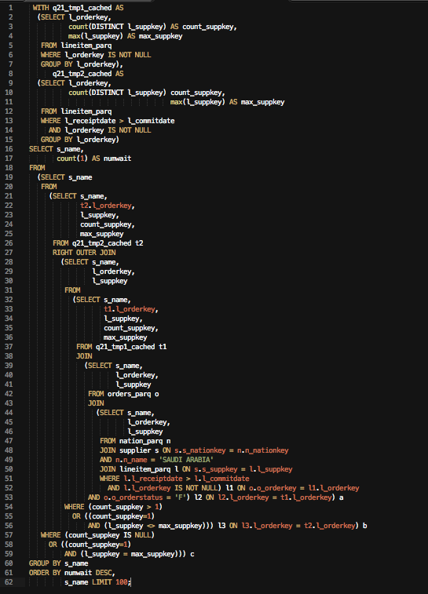
Use ANSI SQL
Start writing ANSI SQL
Support for complex joins, nested queries & window functions
Support for complex data types (arrays, structs)
Support for partitioning of data by any key
(date, time, custom keys)
e.g., Year, Month, Day, Hour or Customer Key, Date
© 2018, Amazon Web Services, Inc. or its affiliates. All rights reserved.

Slide 14
Athena is Highly Available
© 2018, Amazon Web Services, Inc. or its affiliates. All rights reserved.

Slide 15
Amazon Athena is Highly Available
You connect to a service endpoint
or log into the console
Athena uses warm compute pools across multiple Availability Zones so customers don’t manage clusters
Your data is in Amazon S3, which is also highly available and designed for 99.999999999% durability
© 2018, Amazon Web Services, Inc. or its affiliates. All rights reserved.

Slide 16
Athena is Secure
© 2018, Amazon Web Services, Inc. or its affiliates. All rights reserved.

Slide 17


Amazon Athena is Secure
Control access to your data by using:
AWS IAM Policies
Access Control Lists (ACLs)
S3 bucket policies
Encryption: Read from and write to encrypted data stored in Amazon S3. Server-side and client-side encryption supported.
© 2018, Amazon Web Services, Inc. or its affiliates. All rights reserved.

Slide 18
Athena is Cost Effective
© 2018, Amazon Web Services, Inc. or its affiliates. All rights reserved.

Slide 19
Amazon Athena is Cost Effective
Pay per query
$5 per TB scanned from S3
DDL Queries and failed queries are free
Save by using compression, columnar formats, partitions
© 2018, Amazon Web Services, Inc. or its affiliates. All rights reserved.

Slide 20
Data Partitioning
Separates data files by any column
Read only data the query needs
Reduce amount of data scanned
Decrease query completion time
Reduce query cost
Define Partitions at the time of creating tables.
Partitions are virtual columns that you can reference in your query
Amazon Athena uses Hive-style partitioning
Works on both text and columnar data
© 2018, Amazon Web Services, Inc. or its affiliates. All rights reserved.

Slide 21
Partitioning of data has cost advantages
Query | Non-Partitioned Table |  | Cost | Partitioned table |  | Cost | Savings
 | Run time | Data Scanned |  | Run time | Data Scanned
SELECT count(*) FROM lineitem WHERE l_shipdate = ‘1996-09-01’ | 9.71 seconds | 74.1 GB | $0.36 | 2.16 seconds | 29.06 MB | $0.0001 | 99% cheaper 77% faster
SELECT count(*) FROM lineitem WHERE l_shipdate >= ‘1996-09-1’ AND l_shipdate < ‘1996-10-01’ | 10.41 seconds | 74.1 GB | $0.36 | 2.73 seconds | 871.39 MB | $0.004 | 98% cheaper 73% faster
© 2018, Amazon Web Services, Inc. or its affiliates. All rights reserved.

Slide 22
Athena is Fast
© 2018, Amazon Web Services, Inc. or its affiliates. All rights reserved.

Slide 23

Amazon Athena is Fast
Tuned for performance
Automatically parallelizes queries
Results are streamed to console
Results also stored in S3
Improve Query performance
Compress your data
Use columnar formats
© 2018, Amazon Web Services, Inc. or its affiliates. All rights reserved.

Slide 24
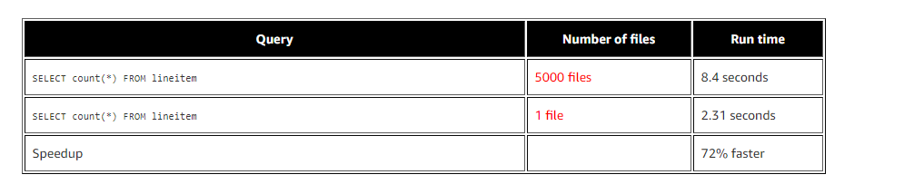
Query performance: bigger files help
© 2018, Amazon Web Services, Inc. or its affiliates. All rights reserved.

Slide 25
Query performance: ORC and Parquet
Dataset | Size on S3 | Query run time | Data Scanned | Cost
Text | 1.15TB | 236 seconds | 1.15 TB | $5.75
Parquet (same data) | 130GB | 6.78 seconds | 2.51 GB | $0.013
Savings/ Speed up | 87% less with Parquet | 34 x | 99% less data scanned | 99.7% savings
© 2018, Amazon Web Services, Inc. or its affiliates. All rights reserved.

Slide 26
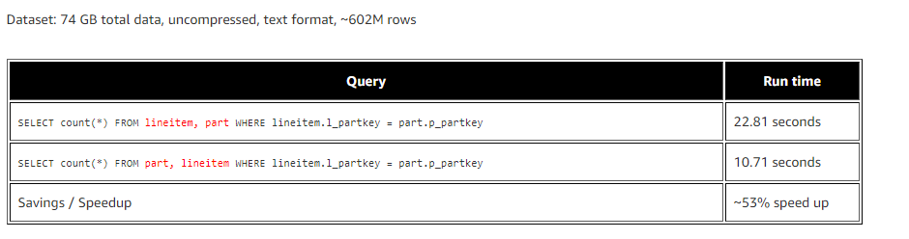
Query performance: Joins
Keep the larger Table on the Left Side of the Join !
© 2018, Amazon Web Services, Inc. or its affiliates. All rights reserved.

Slide 27
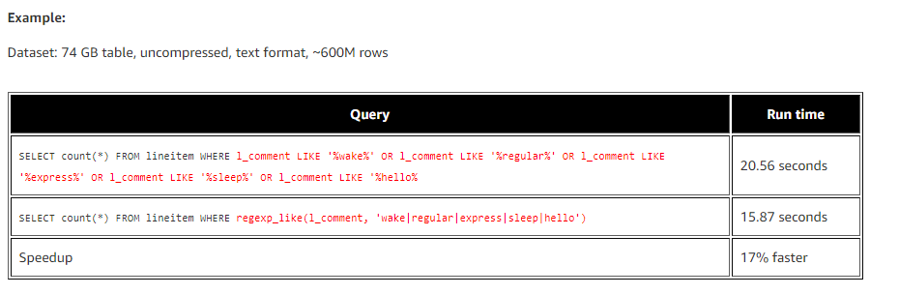
Query performance: Regex better than Like
© 2018, Amazon Web Services, Inc. or its affiliates. All rights reserved.

Slide 28
Athena is Integrable
© 2018, Amazon Web Services, Inc. or its affiliates. All rights reserved.

Slide 29
Athena leverages AWS Glue Data Catalog
Unified metadata repository across relational databases, Amazon RDS, Amazon Redshift, and Amazon S3…with support for more coming soon!
Get a single view into your data, no matter where it is stored
Automatically classify your data in one central list that is searchable
Track data evolution using schema versioning
Query your data using Amazon Athena or Amazon Redshift Spectrum
Hive metastore compatible; can be used as an external Hive Metastore for applications running on Amazon EMR
© 2018, Amazon Web Services, Inc. or its affiliates. All rights reserved.

Slide 30






Athena leverages AWS Glue Data Catalog
Glue ETL
Amazon RDS
Describes
Glue
Data Catalog
Amazon Athena
Uses
Uses
Describes
Uses
Amazon Redshift
Uses
Describes
Redshift Spectrum
EMR (Hadoop/Spark)
Amazon S3
© 2018, Amazon Web Services, Inc. or its affiliates. All rights reserved.

Slide 31









Integration with several partners
© 2018, Amazon Web Services, Inc. or its affiliates. All rights reserved.

Slide 32
Who is Athena for?
© 2018, Amazon Web Services, Inc. or its affiliates. All rights reserved.

Slide 33
Who is Athena for?
Anyone looking to process data stored in Amazon S3
Data coming from IoT Devices, Apache Logs, Omniture logs, CF logs, Application Logs
Anyone who knows SQL
Both developers or Analysts
Ad-hoc exploration of data and data discovery
Customers looking to build a data lake on Amazon S3
© 2018, Amazon Web Services, Inc. or its affiliates. All rights reserved.

Slide 34







Use Case 1: Query Engine for the Data Lake
Your data
Web app data
AWS Glue ETL
Amazon RDS
Other databases
AMAZON QUICKSIGHT
On premises data
Streaming data
© 2018, Amazon Web Services, Inc. or its affiliates. All rights reserved.

Slide 35





Use Case 2: Embed SQL to allow direct access to data
Data Catalog
Hot data
S3
Application request
Warm & cold data
Query data
Athena
© 2018, Amazon Web Services, Inc. or its affiliates. All rights reserved.

Slide 36


Use Case 3: Querying logs
Lambda
AWS Glue Data Catalog
Update table partition
Create partition
on S3
New File
Trigger
AWS Service Logs
Web Application Logs
Server Logs
S3
S3
Query data
Copy to new
partition
Amazon
Athena
© 2018, Amazon Web Services, Inc. or its affiliates. All rights reserved.

Slide 37


Use Case 4: Query database backups
Lambda
Update table partition
AWS Glue Data Catalog
Trigger Lambda
S3
Database Migration
Exported tables in S3
Query data
Database Migration
Service
Amazon
Athena
© 2018, Amazon Web Services, Inc. or its affiliates. All rights reserved.

Slide 38
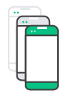

Use Case 5: Time-series data
Lambda
Update table partition
AWS Glue Data Catalog
Trigger Lambda
S3
Real-time events
Store partitioned in S3
Query data
Amazon
Athena
Kinesis
© 2018, Amazon Web Services, Inc. or its affiliates. All rights reserved.

Slide 39
Customer Story: Havas Media Group
Antonio Tajuelo
Alejandro Díaz
Product Manager, Havas Group (DBi)
Solutions Architect, Havas Group (DBi)

Slide 40


About Havas Media Group and DBi
Havas Group is one of the biggest advertisement agencies in the world and specifically in Spain. It employees 20,000+ people in 100+ countries.
DBi is the Havas Group’s data consultancy and advertisement technology company.
DBi’s main projects are about:
Advertisement tracking and optimization.
Data visualization, attribution models and analysis.
Technological product development, like DBi Suite.

Slide 41



About DBi Suite
DBi Suite is a product that allow lead-generation based companies to improve their business results.
Lead generation businesses usually close their sales in a contact center.
For example: telco, finance, insurance, home services, auto…
Some of our customers:

Slide 42


DBi Suite Solves 2 Big Challenges
Challenge: “Customer experience at the web landing page is bad and doesn’t adapt to each user unique needs.” Content Customization Engine – Technology that generates dynamic web pages with customized content for every user.
Challenge: “We can only know call center results at the campaign level by using multiple phone numbers.” User-Level Call Tracking – Technology that displays a unique phone number to each user in the website and contact center integration.
All the data is stored in a centralized data lake for analysis and reporting.

Slide 43
How have we built it?

Slide 44
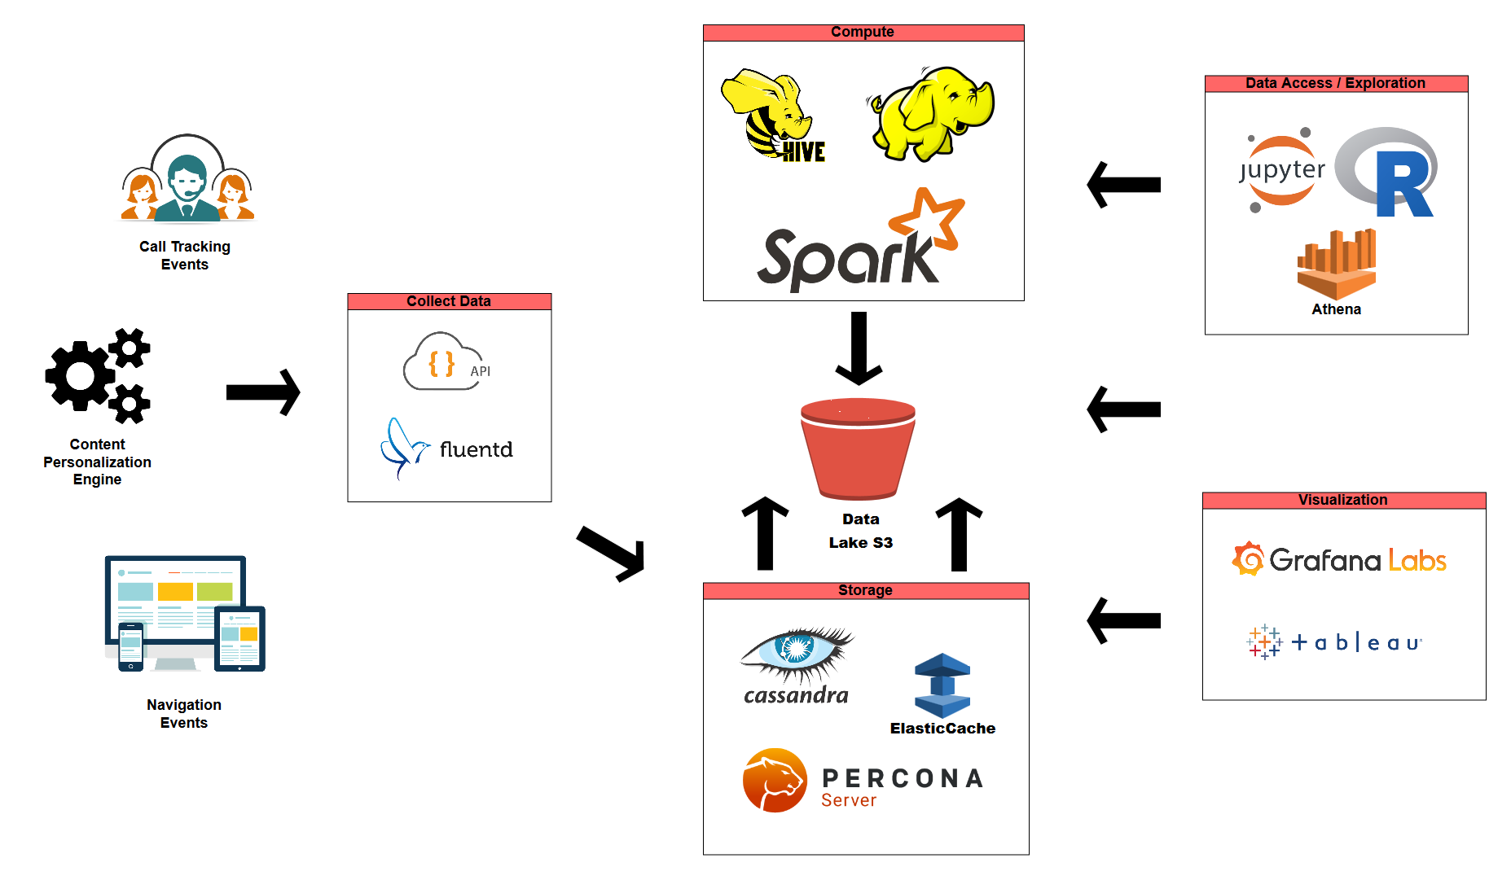
Technology under the DBi Suite

Slide 45
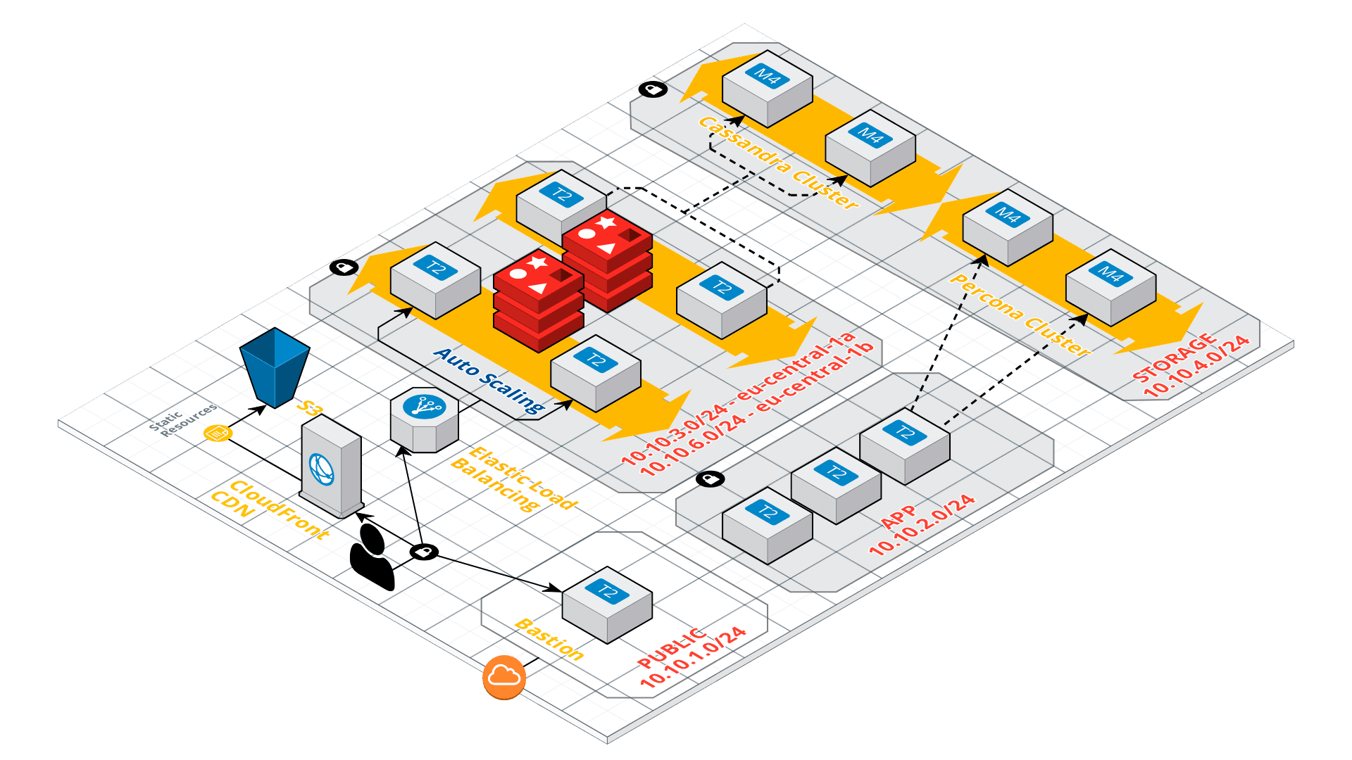
DBi Suite: AWS Architecture I
Data Collection

Slide 46
DBi Suite: AWS Architecture II
Data Storage

Slide 47
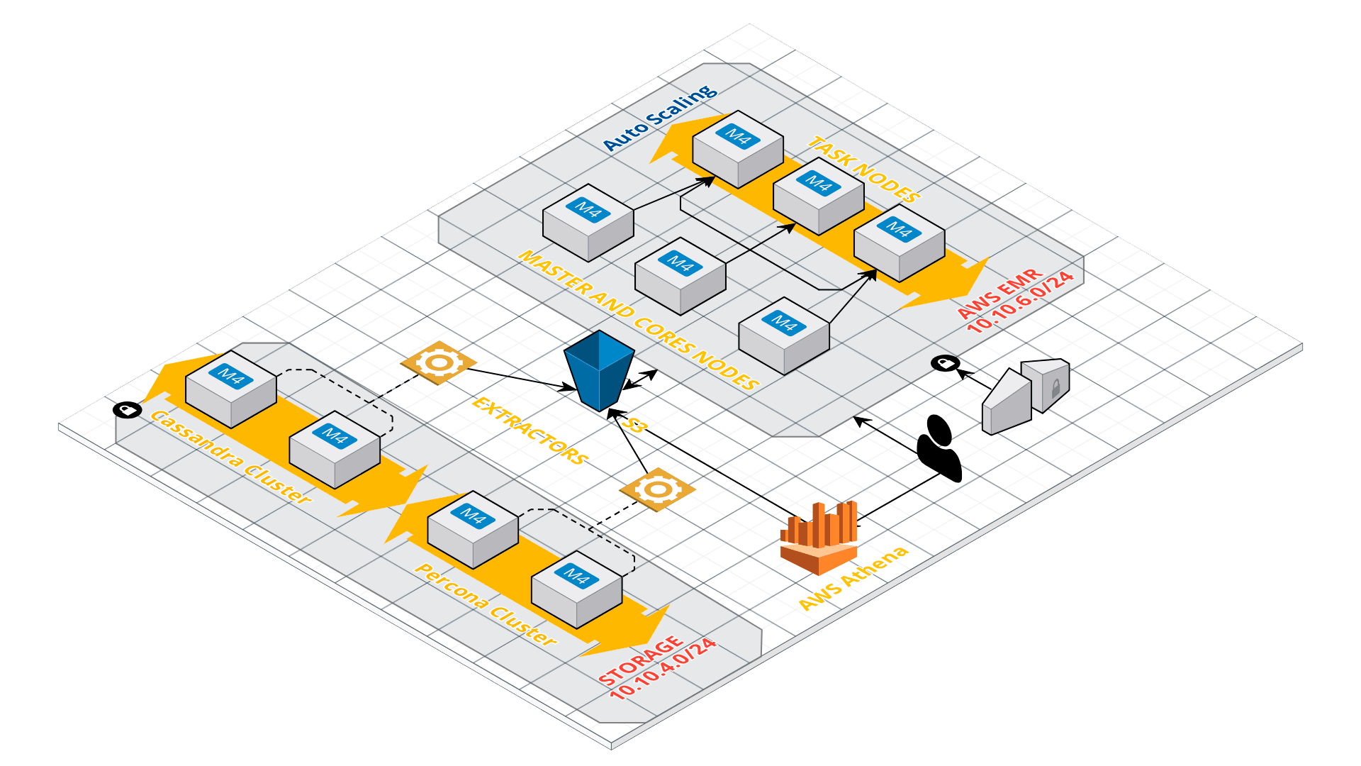
DBi Suite: AWS Architecture III
Data Transformation

Slide 48
DBi Suite: AWS Architecture IV
Service

Slide 49





AWS Athena in DBi Suite
Exploration tool for Analysts people
Quick answers and insights
Integration with R and Python clients (JDBC)
Amazon Athena
S3
Data Lake

Slide 50
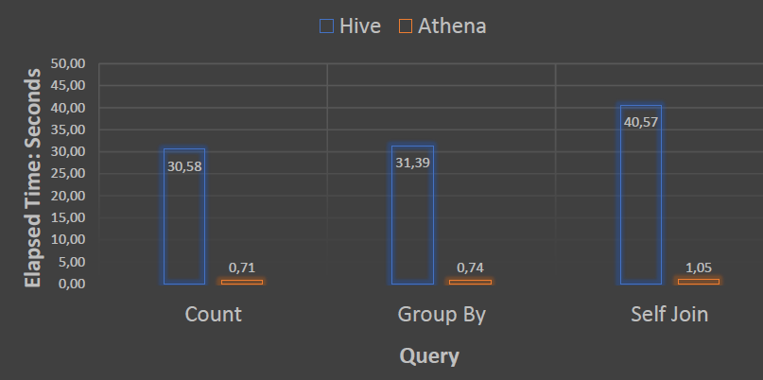
Benefits of AWS Athena in DBi Suite
Cost Effective. Pay per use
Flexibility and Scalability, as data scientist team needs are not easily predictable
High performance
EMR 5.13.0 (March 2018)
Core: m4.xlarge x 2
Master: m4.2xlarge x 1
Task: m4.xlarge x 3 (Spot)
Dataset: Page/View Events
36 columns
~ 1MM rows
Parquet format
43x faster
42x faster
38x faster

Slide 51



Next Steps
Use AWS Glue to transform data:
Our tests show that using columnar formats and compression generate +90% improvements from performance and cost perspectives.
Integrate tools with AWS Athena:
Tableau (live connections)
QuickSight for basic dashboards
Amazon Glue
Amazon QuickSight
Tableau

Slide 52
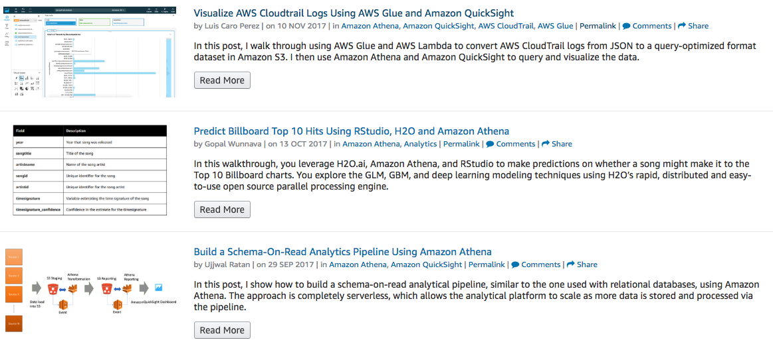
Go build!
AWS Big Data Blog
https://aws.amazon.com/blogs/big-data/
Getting started with Amazon Athena
https://docs.aws.amazon.com/athena/latest/ug/getting-started.html
© 2018, Amazon Web Services, Inc. or its affiliates. All rights reserved.

Slide 53
Thank you!

